Slide 1
Capstone Project

Slide 2
Introduction:
In this project, I will use the data location Foursquare API and some of the machine learning algorithms and data science to solve a business problem. The main objective of the project is to use these available resources for starting a new Restaurants and/or food market business in another city. In the first step, will describe the problem and then data preparation for the analysis then the results and conclusion.

Slide 3
A description of the problem and a discussion of the background
Toronto, city, capital of the province of Ontario, southeastern Canada. It is the most populous city in Canada, a multicultural city, and the country’s financial and commercial center. Also, Toronto is an international center of business, finance, arts, and culture, and is recognized as one of the most multicultural and cosmopolitan cities in the world. So, it considered one of the most preferred destinations for the visitors and tourists to come from inside and outside of Canada and also the immigrant and newcomers from around the globe choose this city as their new home, especially the people from the middle east and/or Arabic people that come from all countries of the Arab world. There is a lot of the population from the middle east/Arabic, so it is a good place to start a new restaurant and/or food market.

Slide 4
Therefore, the main idea is to make a study and analysis and to decide whether it's good to make this business or not.
That is, to use data science methods and the data collected from the Toronto city such as the population distribution and tourist places that attract the visitors and how it's close in location to the city center or downtown and to decide where to open it.

Slide 5
Data Analysis Process
Data Source
Preprocessing Stage
Machine Learning Clustering Algorithm
Results
Diagram of Analysis Process

Slide 6
Dara Preprocessing Stage
Below show the data preprocessing steps and some of the results obtain from the analysis work. Scraping Toronto Neighborhoods Table from Wikipedia website to start working on the data

Slide 7
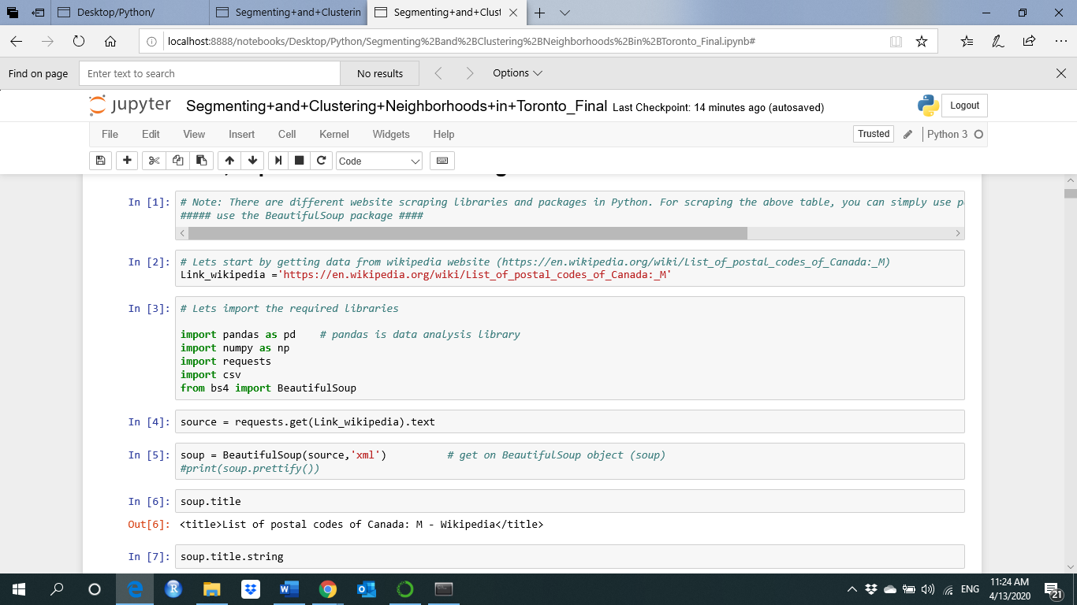
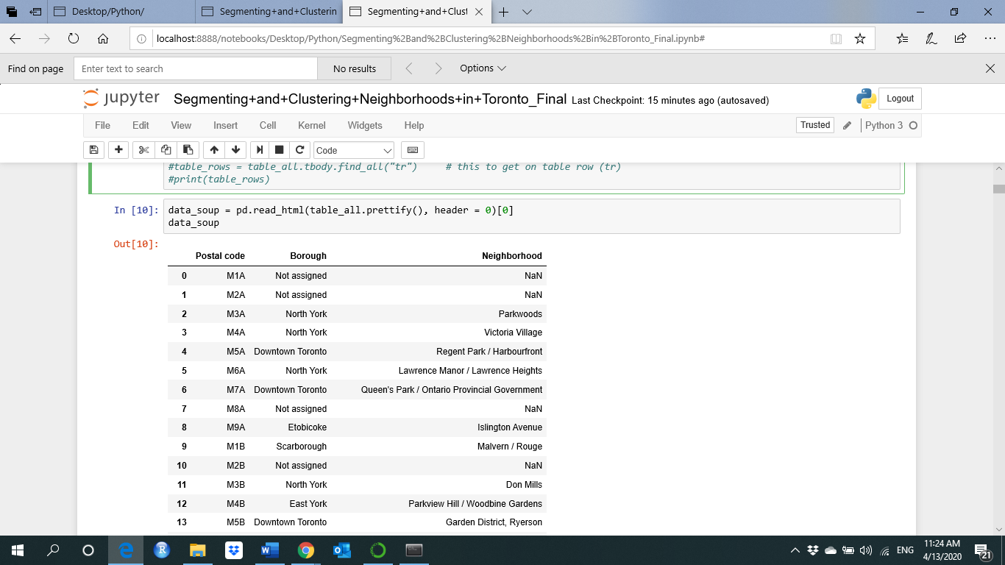
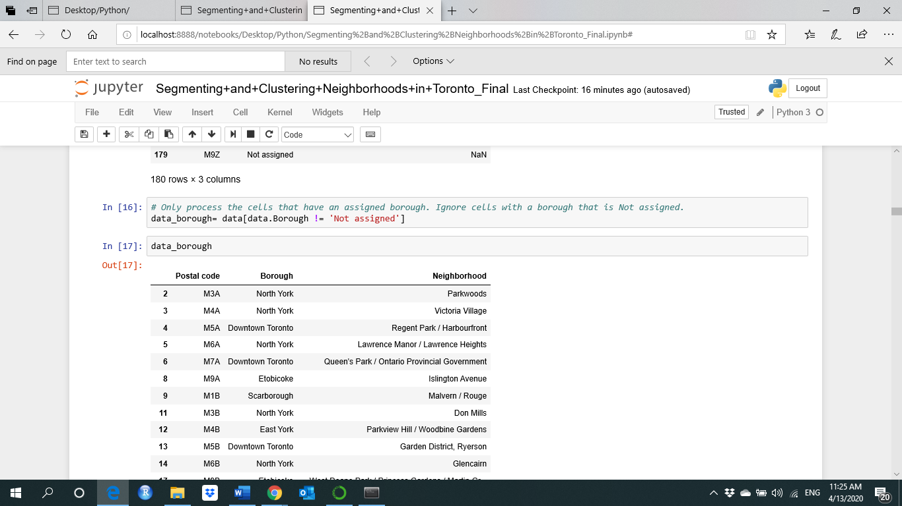
Results

Slide 8
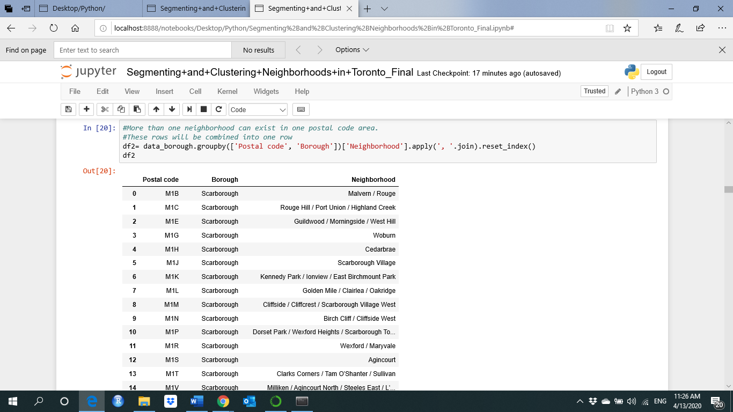
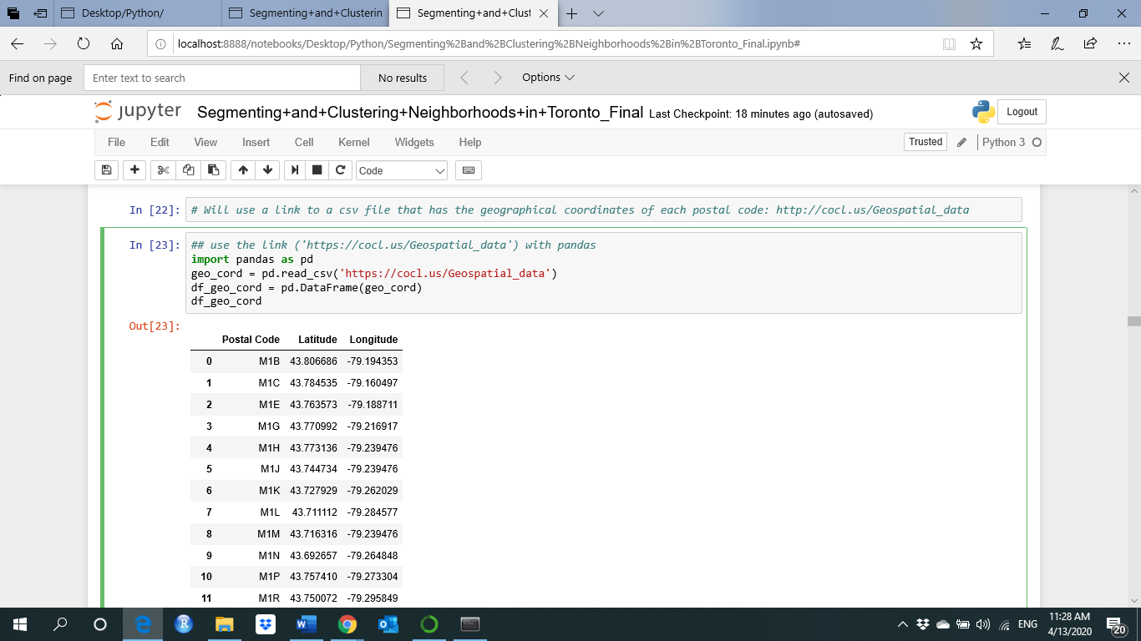
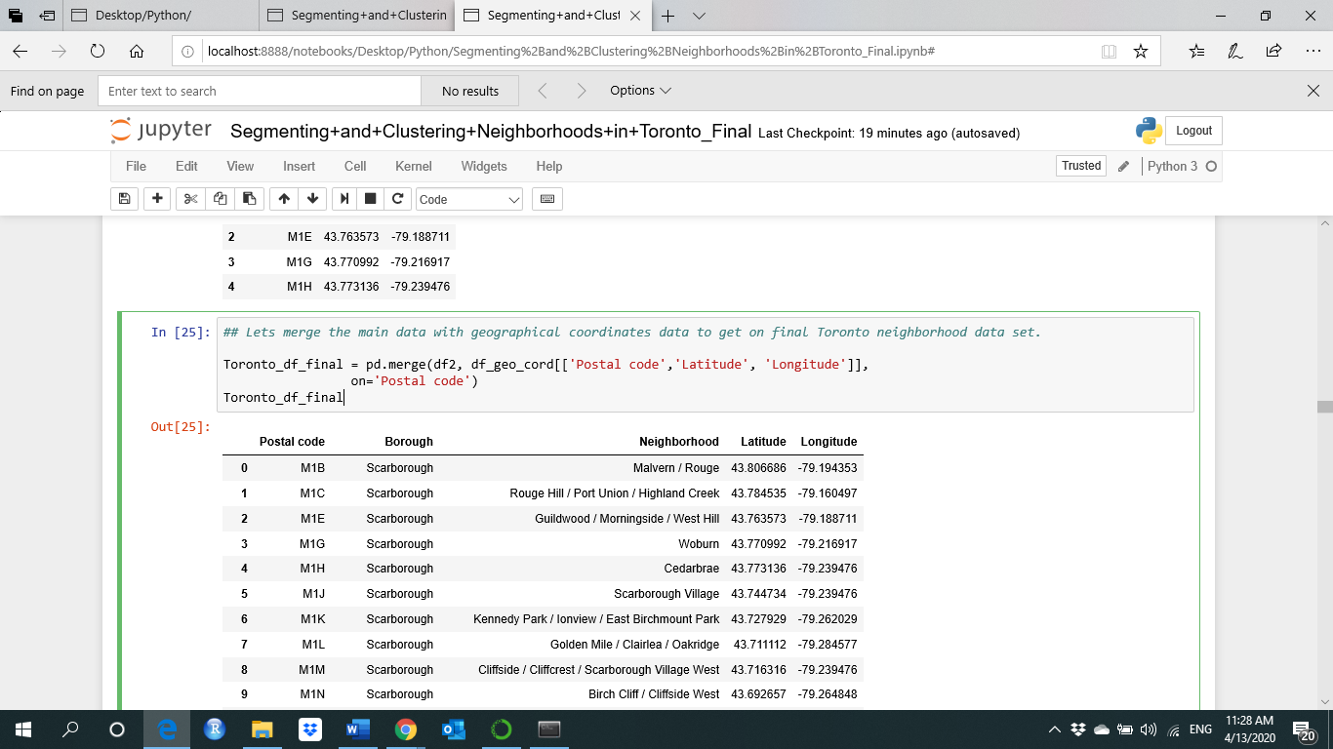
Results (cont)

Slide 9
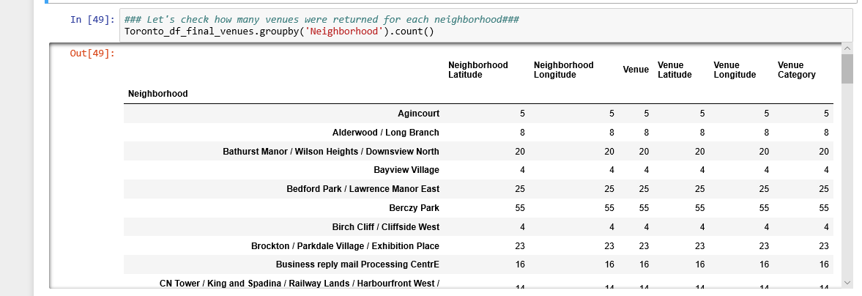
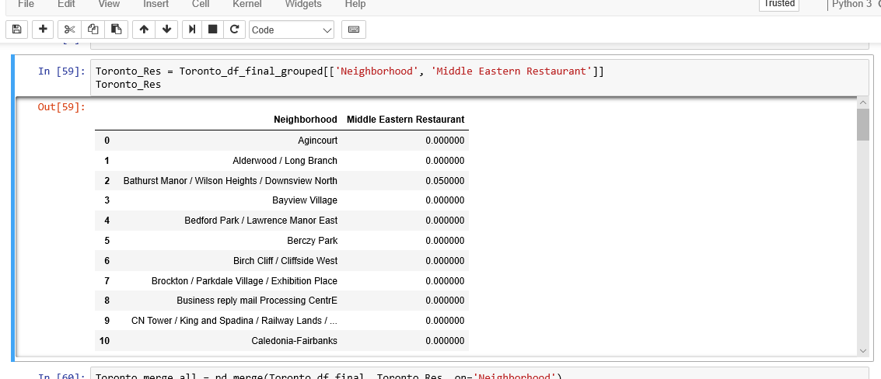
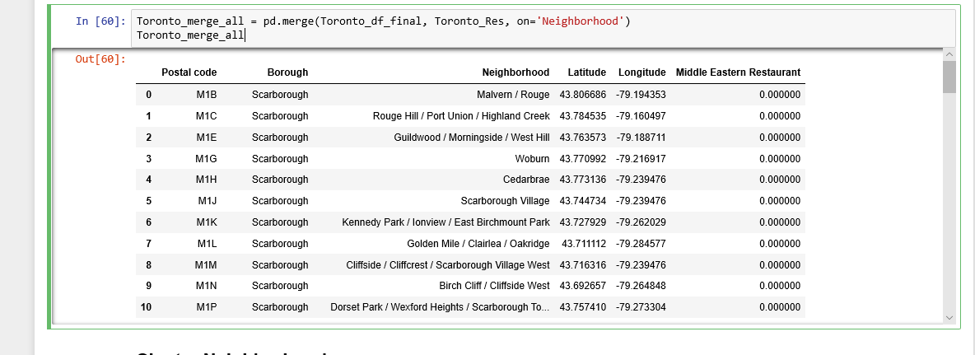
Results (cont)

Slide 10
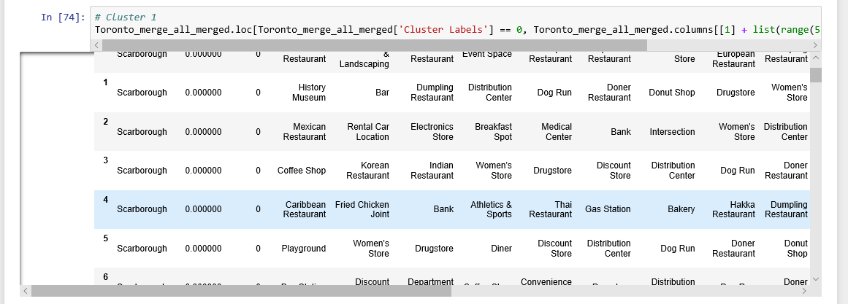
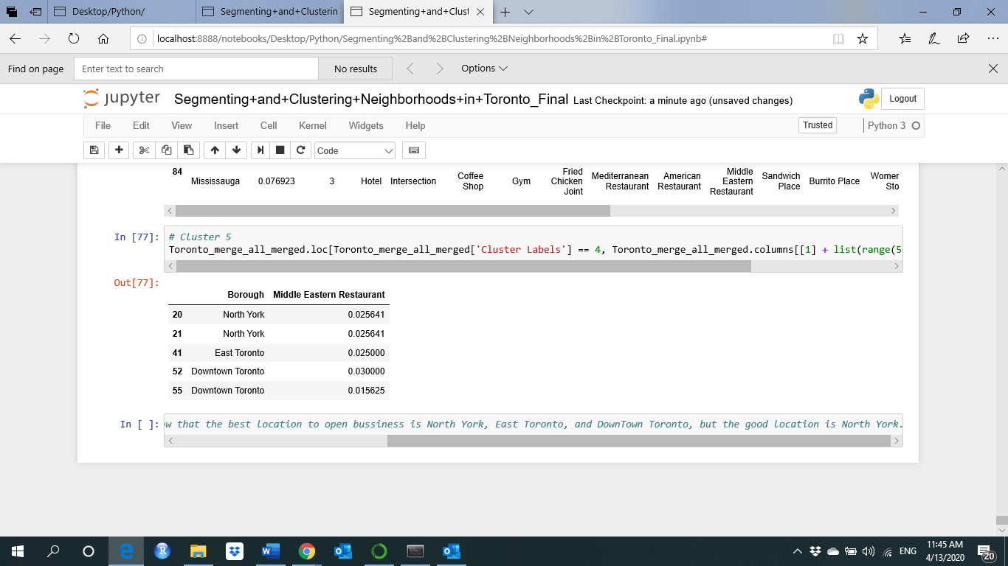
Results (cont)

Slide 11
Results
Some of the obtained results as shown in the above section. We can see from the results, and for example that Cluster 5 contains all the neighborhoods which are highly populated with Middle Eastern Restaurants such as North York, East Toronto, and Downtown Toronto, and some other neighborhood, so its good idea not to make the business in these neighborhoods and build it in another place such as Scarborough or Mississauga because it contains a high population.

Slide 12
Discussion and Conclusions
In this project, we used real data to make an analysis to solve a business problem. Several python libraries and machine learning algorithms used to solve the problem.
In this first analysis and primary investigation, I think and from the first try that the obtained results show that it is good to start the middle east and Arab food market and restaurant in the Scarborough or Mississauga neighborhoods and far away from North York, East Toronto, and Downtown Toronto.

Slide 13
Future Work
In future work, we will make more study and analysis on the city of Toronto i.e. by applying the same process with deeper analysis to the educational institutes and universities such as the University of Toronto and its good to open this business close to this university or others by checking the international student's population number because a lot of international students from middle east and Arab world studying and living in Toronto. Not just for the city of Toronto and maybe go deeper analysis to all the Ontario province with more usage of the population distribution data and to get on more accurate results.

Slide 14
References
https://en.wikipedia.org/wiki/List_of_postal_codes_of_Canada:_M
http://cocl.us/Geospatial_data
https://en.m.wikipedia.org/wiki/Demographics_of_Toronto#Ethnic_diversity
https://developer.foursquare.com/docs

